Slide 1
Module 1: Core Python & Data
Week: 4 Lecture: 16
DatE: 10/09/2025
Instructor: HAMZA SAJID

Slide 2
Today's Agenda
TODAY'S AGENDA
The "What" - What is DML?
Analogy: The Digital Filing Clerk
Core DML Commands
INSERT: Adding new rows (records).
UPDATE: Modifying existing rows.
DELETE: Removing rows.
Real-World Scenarios & Best Practices
Example: Managing an online store's inventory.
Best Practice: The concept of "Soft Deletion."
Putting It All Together & The Hands-On Lab
Hands-On Lab: Managing a Sample Database
Bonus Challenge

Slide 3
BEYOND STRUCTURE: POPULATING OUR DATABASE
Welcome back! In our last lecture, we learned how to build the skeleton of our database with DDL commands like CREATE TABLE. We designed the blueprints and constructed the empty containers for our data.
But an empty database isn't useful. We've built the filing cabinets, but now we need to actually put files in them. How do we add new users, update product information, or remove cancelled orders?
Today, we learn the commands to breathe life into our database structure. We will learn how to populate and manage the data itself using Data Manipulation Language (DML).

Slide 4
The "What" - DML as the Digital Filing Clerk
Last time with DDL, we were the architects—we built the empty filing cabinets (CREATE TABLE) and labeled the drawers (columns).
Now with DML, we become the Digital Filing Clerk. Our job is to manage the actual records that go into those cabinets.
INSERT: "Here is a new form. Please file it in the 'Customers' cabinet."
UPDATE: "Please find Alice Smith's file and change her address."
DELETE: "Please remove Order #102 from the 'Orders' cabinet."
These three commands are how we handle the day-to-day operations of our database.

Slide 5
Core Command 1: INSERT INTO
The INSERT INTO statement is used to add new rows of data to a table.
Scenario: A new customer, 'John Doe', has just created an account in our online store. We need to add his details to our Customers table.
Syntax:
INSERT INTO table_name (column1, column2, column3, ...) VALUES (value1, value2, value3, ...);
Example Query:
INSERT INTO Customers (CustomerName, City, Country) VALUES ('John Doe', 'New York', 'USA');
What it does: This query adds one new row to the Customers table with the specified name, city, and country.

Slide 6
Core Command 2: UPDATE
The UPDATE statement is used to modify existing records in a table.
Scenario 1: Our customer 'Ana Trujillo' has moved from México D.F. to a new city, 'Monterrey'. We need to update her record.
Syntax:
UPDATE table_name SET column1 = value1, column2 = value2, ... WHERE condition;
Example Query:
UPDATE Customers
SET City = 'Monterrey'
WHERE CustomerID = 2;
CRITICAL! The WHERE clause is crucial. If you forget it, you will update every single row in the table!

Slide 7
Core Command 3: DELETE
The DELETE statement is used to remove existing records from a table.
Scenario 1: A product, 'Chai' (ProductID 1), is no longer sold. We need to remove it from our Products table.
Syntax:
DELETE FROM table_name WHERE condition;
Example Query:
DELETE FROM Products
WHERE ProductID = 1;
CRITICAL! Just like UPDATE, the WHERE clause is essential. Forgetting it will delete all data from your table!

Slide 8
Best Practice: The Problem with DELETE
Scenario: A customer places an order and then cancels it a few hours later.
The Naive Approach: DELETE FROM Orders WHERE OrderID = 10285;
The Problem: The order is now gone forever!
We can't track how many orders are cancelled.
We lose historical data that could be useful for business analysis (e.g., "Why are customers in Germany cancelling orders so often?").
It can cause issues if other parts of the database (like shipping records) were linked to that order.
Permanent deletion is often a bad idea in business applications.

Slide 9
The Solution: "Soft Deletion"
Instead of deleting the row, we add a column to our table to track its status. This is called a "soft delete."
Step 1: Add a status column to the Orders table.
Common column names: OrderStatus, IsActive, or IsCancelled.
Step 2: Use UPDATE instead of DELETE.
When an order is cancelled, we don't delete it. We simply update its status.
Example Query:
UPDATE Orders
SET OrderStatus = 'Cancelled'
WHERE OrderID = 10285;
The Benefit: The data is preserved! We can still count cancelled orders, run reports, and maintain a complete history of all business activities.
Another Example: When a user deactivates their social media account, their profile is hidden by setting a flag like IsActive = false, but their data isn't permanently erased, allowing for easy reactivation.

Slide 10
Hands-On Lab: Managing a Sample DB
Goal:
Use Python scripts to programmatically create, populate, and manage a local SQLite database.
Tools:
Python 3 (and its built-in sqlite3 module).
VS Code + the "SQLite" extension (by alexcvzz) for viewing and verifying our database.
Setup:
Create a new, empty folder for our project in VS Code.
We will write Python scripts (.py files) to execute our SQL commands.
The Python script will automatically create the database file (e.g., store.db) in our folder.

Slide 11
Step 1: Create & Populate with Python
Task: Write a Python script that creates our database file, defines the table schema, and inserts the initial data.
Instructions: Create a new file named setup_database.py and add the following code. Then, run it from the VS Code terminal (python setup_database.py).

Slide 12
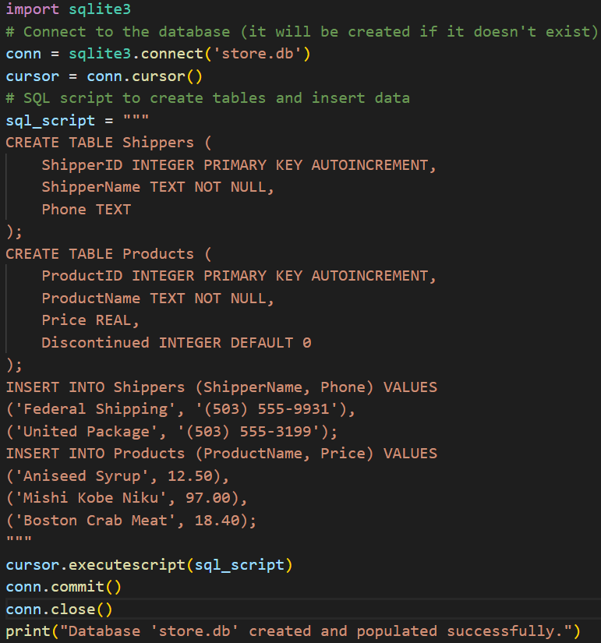
code

Slide 13
Step 2: Inserting Data with Python
Task: Write a new script to add the "Speedy Express" shipper.
Instructions: Create a file named add_shipper.py and run it. In this example, we will build the full SQL command as a string in Python.

Slide 14
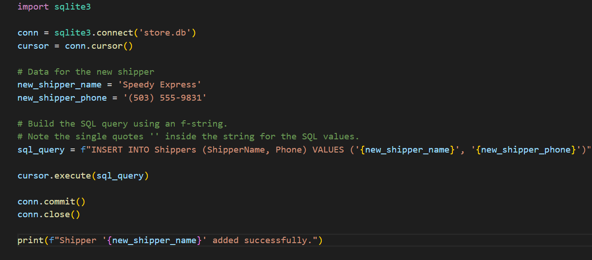
code

Slide 15
Step 3: Updating Data with Python
Task: Write a script to correct the price of "Aniseed Syrup" to 10.00.
Instructions: Create a file named update_price.py and run it.

Slide 16
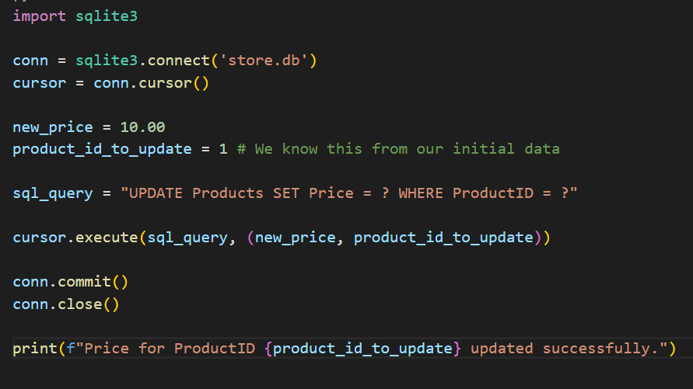
code

Slide 17
Step 4: Soft Deleting with Python
Task: Write a script to discontinue the product "Mishi Kobe Niku" by setting its Discontinued flag to 1.
Instructions: Create a file named discontinue_product.py and run it.

Slide 18
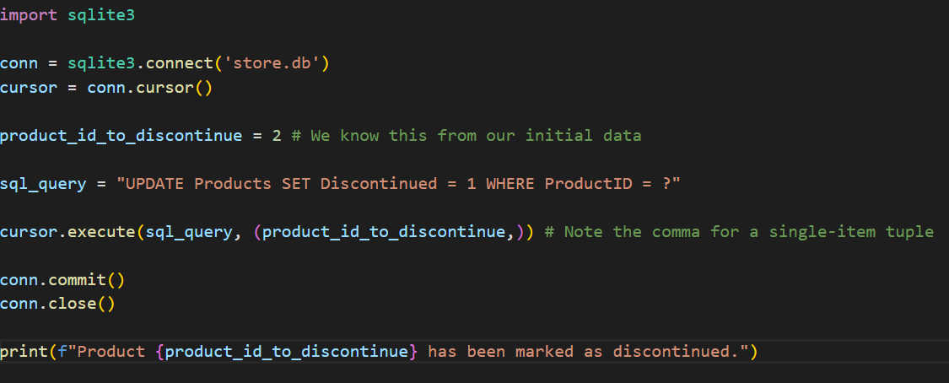
code

Slide 19
BONUS CHALLENGE
Challenge 1: The Big Sale
Write a Python script that reduces the price of all products currently over $15.00 by 20%.
Hint: Your SQL query will be UPDATE Products SET Price = Price * 0.80 WHERE Price > 15;. Execute this from a Python script.
Challenge 2: Inventory Management
Write a single Python script that performs two actions:
Adds a new column called StockQuantity (INTEGER) to the Products table.
Updates the stock for all existing products to 50.
Hint: You will need two cursor.execute() calls in your script, one for ALTER TABLE and one for UPDATE.

